Slide 1

C++ Programming
Part 2
Michael Griffiths
Corporate Information and Computing Services
The University of Sheffield
Email m.griffiths@sheffield.ac.uk

Slide 2
Presentation Outline
Scoping and Namespaces
The Standard template library

Slide 3
Namespaces and Scopes
Scoping and the Scope Resolution Operator ::
Scope of an identifier is that portion of the application within which the identifier can be referenced
When a local variable is defined within a block (e.g. in a function or in between {}
  Can only be used in that function or block
  This is the scope

Slide 4
Types of scope
function
block
file
global
Function-prototype

Slide 5
The scope resolution operator ::
Using the :: operator
  ::varname
  Scopename::varname
Example – global variable defined outside main
  float var=0; //Global variable
  main()
  {
  float var=1.0; //Local variable to main
  cout << "Local var in outer scope of main is "
  << var << endl;
  cout << "using the unary scope resolution operator " << endl
  << "Global var is " << ::var << endl;
  ……..
  }

Slide 6
Namespaces
Mechanism to avoid name collisions between functions, variables and overloaded binary operations
Enable grouping of global classes, objects, functions etc. under a name
  Global scope is split into sub-scopes known as namespaces

Slide 7
Using namespaces
Declaration
  namespace identifier
  {
  namespace-body
  }

Slide 8
namespaces example
namespace first
{
int var=5;
}
namespace second
{
double var=3.141;
}
int main()
{
cout << "Namespace first " << first::var << endl;
cout << "Namespace second " << second::var << endl;
return 0;
}

Slide 9
using namespace
Specify the namespace being used
  Scope resolution operator namespace::variable
  using namespace identifier
Namespace std
  ANSI C++ standard ALL classes, objects and functions of standard C++ library defined within namspace std
Example ANSI C++ compliant Hello World (note omits .h from include statement)
#include <iostream>
int main ()
{
std::cout << "Hello world in ANSI-C++\n";
return 0;
}

Slide 10
using namespace std
#include <iostream>
using namespace std; //if this is omitted
//need to use the operator std::
//to access the iostream library functions
//such as cout.
namspace declarations
…..
…..
main()
{
}

Slide 11
Referring to different namespace s
int main()
{
cout << "Namespace first " << first::var << endl;
cout << "Namespace second " << second::var << endl;
{
using namespace first;
std::cout << "Using namespace first " << var << std::endl;
}
{
using namespace second;
std::cout << "Using namespace second " << var << std::endl;
}
return 0;
}

Slide 12
Standard Template Library
ANSI-compliant way to include the standard libraries is highly recommended for STL users
Templates
  A new feature introduced by ANSI-C++ standard.
  C++ compiler must comply with the standard
  Range of container and general utilities available
  Efficient use of these templates can lead to rapid development well engineered applications. Templates are described and demonstrated briefly below.

Slide 13
Reasons for Using STL
Efficient use of these templates can lead to rapid development well engineered applications. Templates are described and demonstrated briefly below.
Easy to maintain
Portable

Slide 14
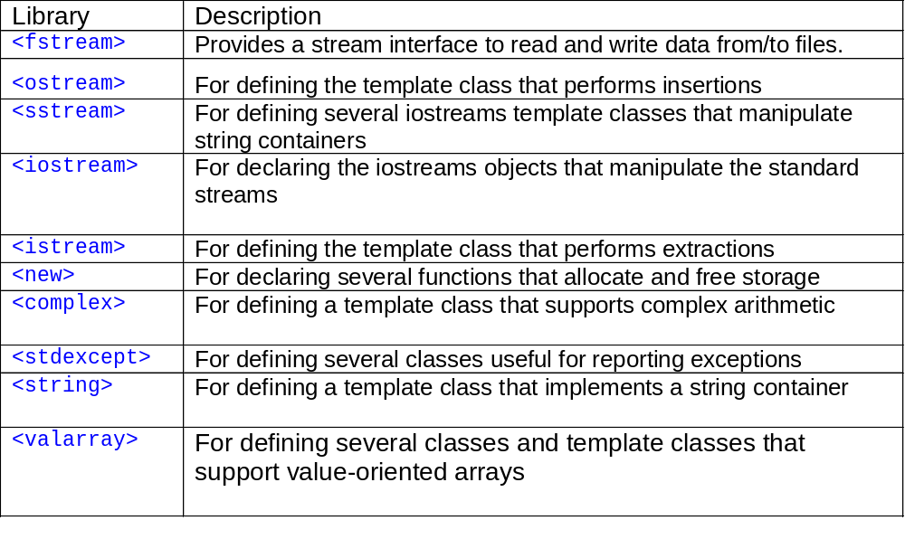
Standard libraries with C++

Slide 15
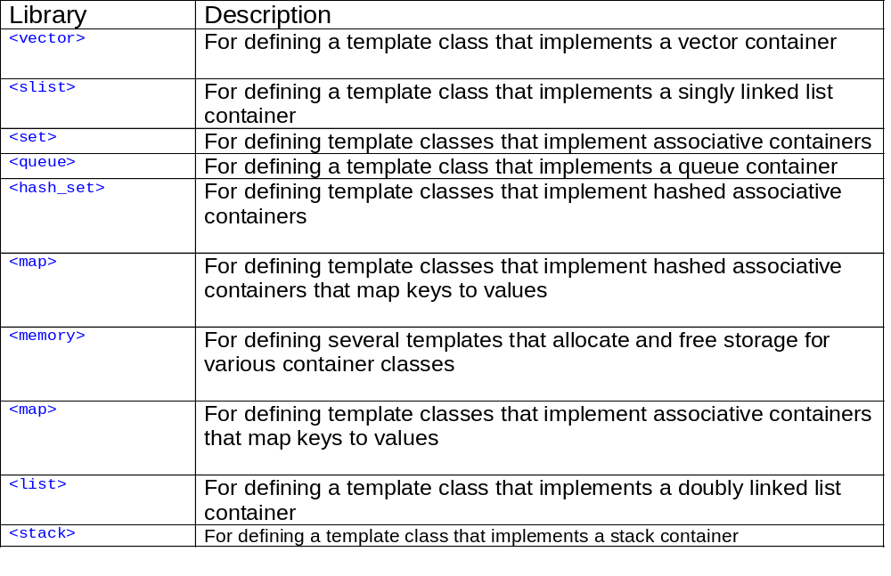
STL Collection Classes

Slide 16
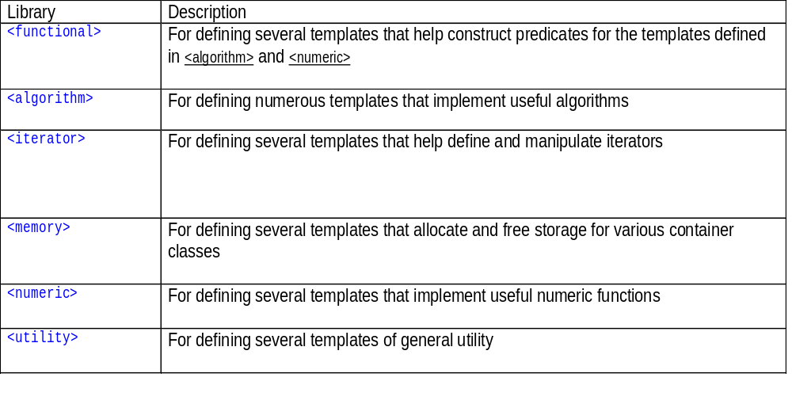
STL Template Classes

Slide 17
String manipulation using STL
Namespace std defines
  typedef basic_string<char> string;
Initialisation
  string text(“Hello”);
  string name(8, ‘x’);
Provides default
  Constructor
  Copy Constructor

Slide 18
String operations
Assignment
  mystring.assign(string, pos, size)
  mystring = anotherstring;
  mystring.append(anotherstring);
  mystring+=anotherstring;
Streaming
  cout << mystring;
Comparison
  Mystring.compare(anotherstring);
Swap two strings
  mystring.swap(anotherstring)

Slide 19
vector
Declaration
#include <vector>
using namespace std;
Define a vector of integers.
The template name is "vector"
  the type of object it contains is "int";
The fully specified container data type is
  vector<int>

Slide 20
Initialising a Vector
vector<int> vec_one;
int a = 2; // Some integer data objects
int b = -5;
vec_one.push_back(a); // Add item at end of vector vec_one.push_back(9);
vec_one.push_back(b);

Slide 21
Accessing Vector Elements
Use [] operator to access elements
// vec_one now contains three int values: 2, 9, -5
unsigned int indx;
for (indx = 0; indx < vec_one.size(); indx++)
{
cout << vec_one[indx] << endl;
Write out vector item
}

Slide 22
STL Iterators
iterator pointer to an item that is part of a larger container of items.
Containers support a function called begin,
  returns an iterator pointing to the beginning of the container (the first element) and
Containers support a function called end,
  returns an iterator corresponding to having reached the end of the container.
Access elements by "dereferencing" the iterator with a *, just as you would dereference a pointer.

Slide 23
Initialising an Iterator
To request an iterator appropriate for a particular STL templated class, you use the syntax
std::class_name<template_parameters>::iterator name
where
name is the name of the iterator variable you wish to create
class_name is the name of the STL container you are using
template_paramters are the parameters to the template used to declare objects that will work with this iterator.
  because the STL classes are part of the std namespace, you will need to either prefix every container class type with "std::", as in the example, or include "using namespace std;" at the top of your program.

Slide 24
Example vector<int> Iterator
For instance, if you had an STL vector storing integers, you could create an iterator for it as follows:
std::vector<int> myIntVector;
std::vector<int>::iterator myIntVectorIterator;

Slide 25
Using An Iterator
vector<int> myIntVector;
vector<int>::iterator myIntVectorIterator;
// Add some elements to myIntVector
myIntVector.push_back(1);
myIntVector.push_back(4);
myIntVector.push_back(8);
for(myIntVectorIterator = myIntVector.begin(); myIntVectorIterator != myIntVector.end(); myIntVectorIterator++)
{
//Should output 1 4 8
cout<<*myIntVectorIterator<<" ";
}

Slide 26
Iterator Types
Different operations and containers support different types of iterator behaviour.
Several different classes of iterators
  slightly different properties.
  distinguished by whether you can use them for reading or writing data in the container.
  Some types of iterators allow for both reading and writing behavior, though not necessarily at the same time.
forward, backward and the bidirectional iterators.
  used as either input or output iterators,
  The forward iterator only allows movement one way –
    from the front of the container to the back.
    To move from one element to the next, the increment operator, ++, can be used.

Slide 27
Recommendation
Do not mix C and C++ Programming Styles
  External c libraries can still be called
For C++ programs use the ANSI C++ header nad not the ANSI C headers standard libraries
Keep things simple
  Build Create new classes when necessary
  Take care when using inheritance
Avoid re-inveting the wheel, use SDK’s
  See the code repository references below

Slide 28
Conclusion
Advantages
  Powerful development language for HPC applications
  Portable
  Reusable
  Requires careful design
  Wide range of libraries enabling high performance and rapid development.
Disadvantage
  Very easy to develop sloppy and inefficient code!!!!!!!!

Slide 29
References
http://www.cplusplus.com
Standard template libraries
  http://www.sgi.com/tech/stl/table_of_contents.html
Bjarn Stroustrups homepage
  http://www.research.att.com/~bs/homepage.html
Documentation for Sun Compilers
  http://developers.sun.com/prodtech/cc/compilers_index.html

Slide 30
Code Respositories
http://sourceforge.net/
http://www.netlib.org/
http://freshmeat.net/
http://archive.devx.com/sourcebank/
http://www.boost.org/
http://www.oonumerics.org/oon/

